Slide 1

MacAwesomeZA Digital Media Marketing

Slide 2
About Us:
We are an effective Marketing Media house team of professionals and experienced individuals, based in Johannesburg. Driven by a goal to create communications strategies and solutions for our clients in order to help them better connect with their audience. We enjoy applying our skills and experience to each project we involved in. From creative problem solving and innovative ideas, to integrated and collaborative strategist, we always bring our strong eye for detail and positive attitude in everything that we do. Our mission is to strive for innovative and fresh Brand awareness strategies.

Slide 3
SERVICES
Social media Accounts creation and Management
Social Media Amplification
Digital Marketing Data analysis report
ORM (Online Reputation Management)
Marketing Strategy consultation
Call to Action (CTA) Marketing
PR Marketing
Event/Activation Marketing
Direct Marketing
Content Marketing

Slide 4
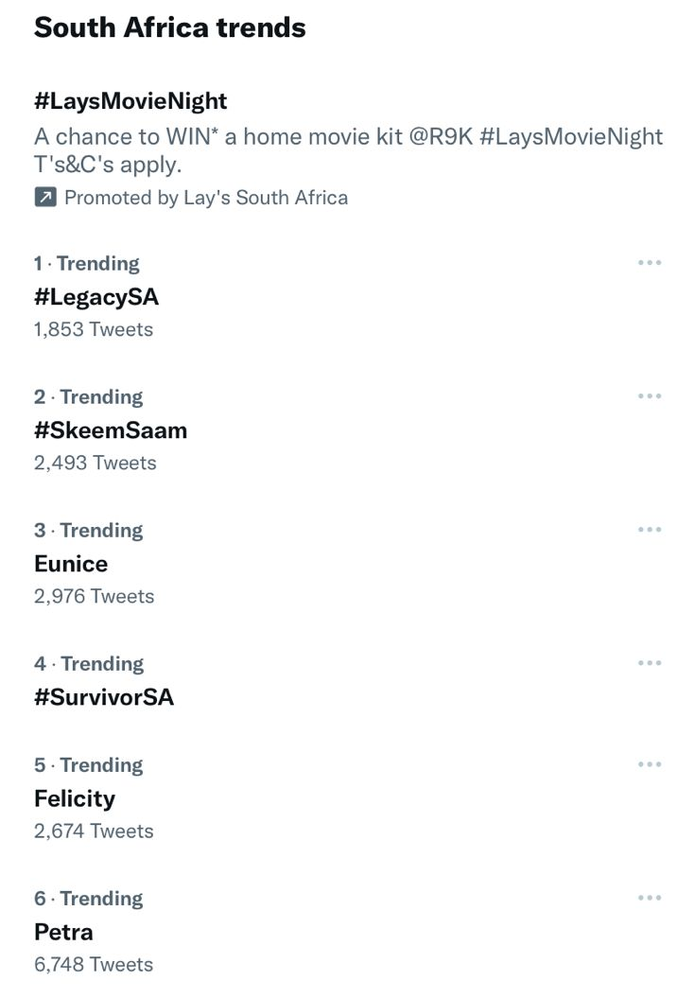
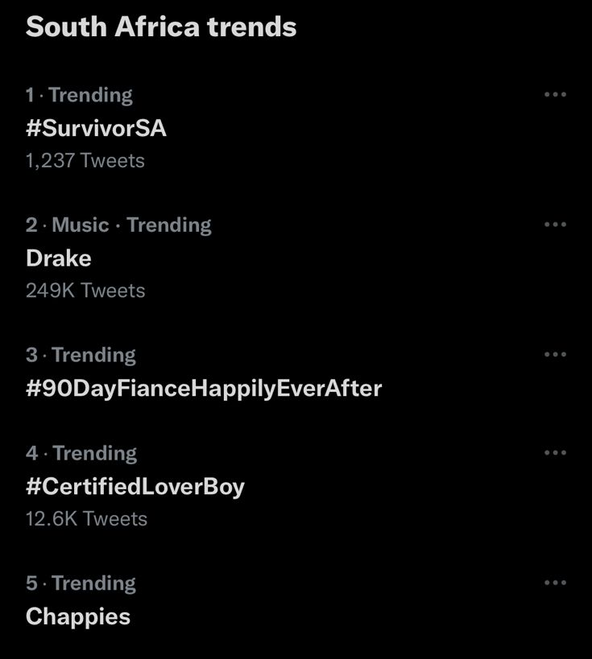
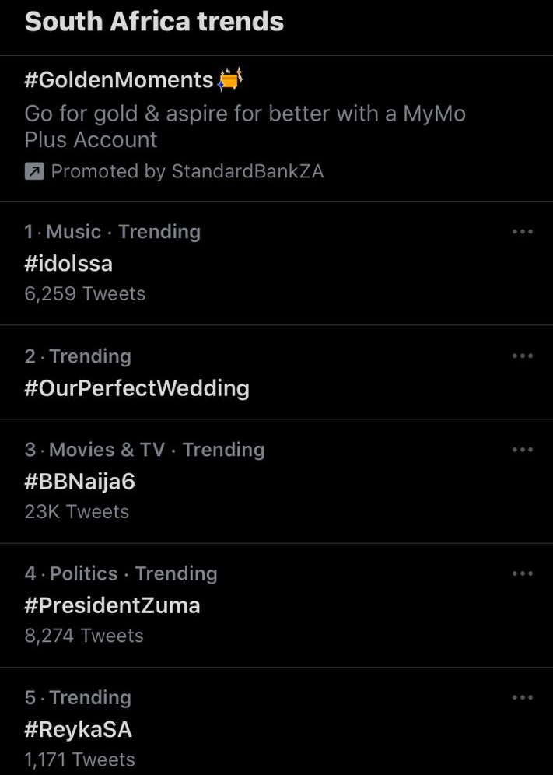
Social Media Amplification
Planning and Execution of social Media amplification Campaign. Using Macro-Influencers and Micro-Influencers to carry out messaging about product/services/brand on different social media platforms. Increasing engagement and organic conversations and tapping in to South African Trend lists.

Slide 5
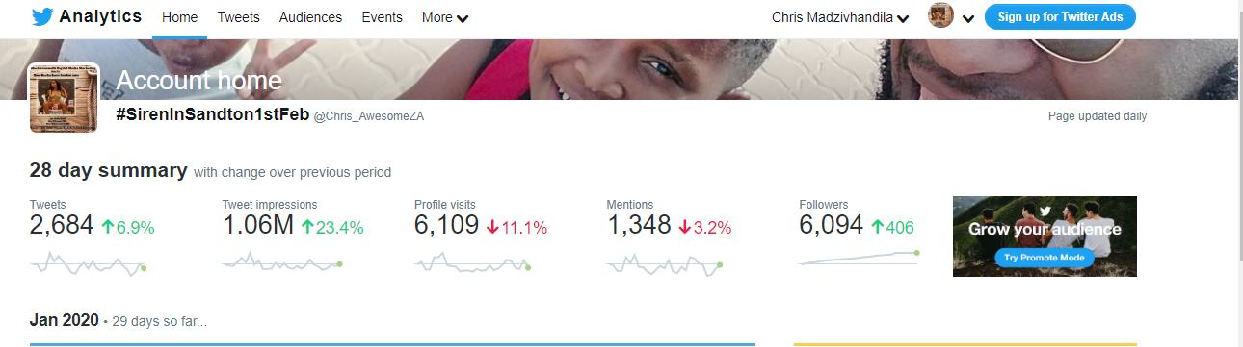
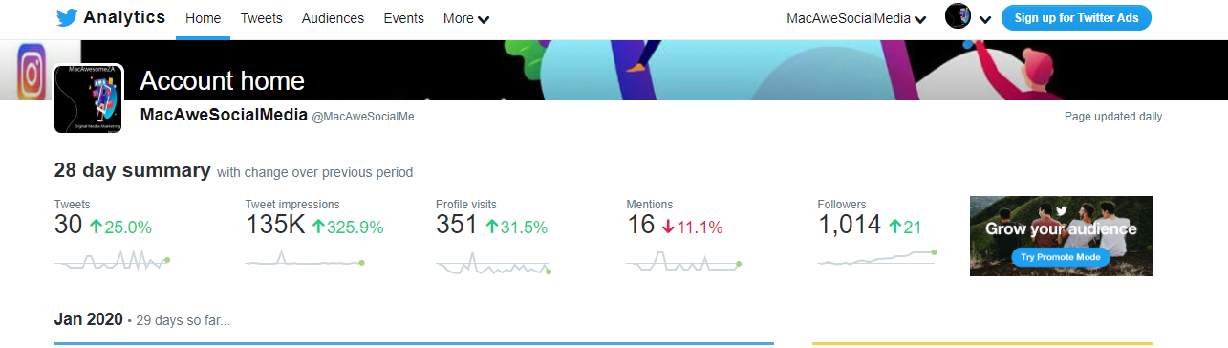
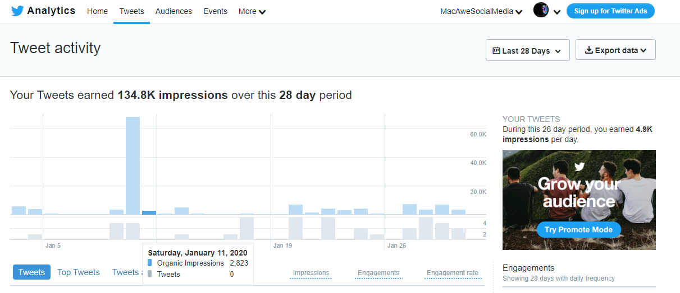
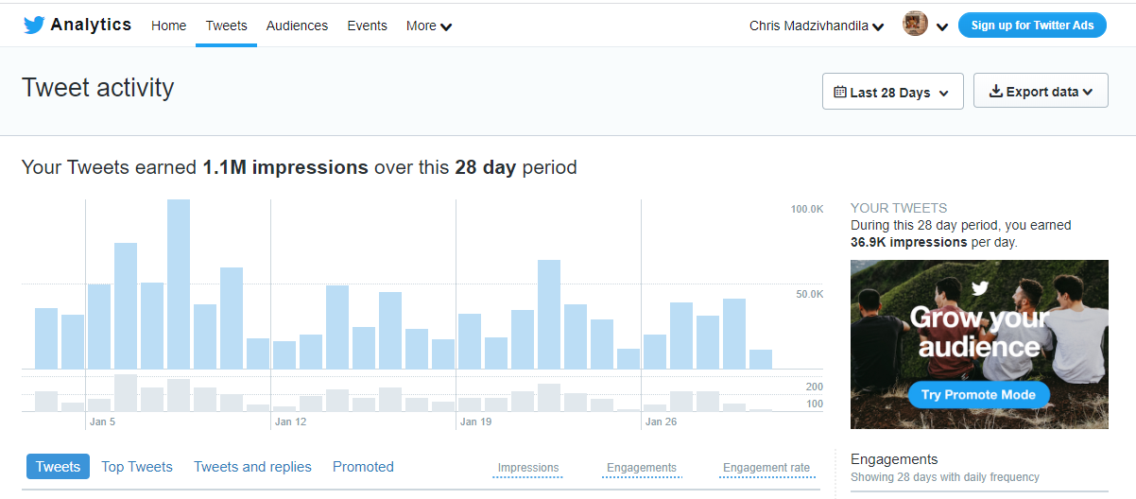
DATA ANALYSIS REPORTS
We strive to ensure a complete customer satisfaction. With our Data Analysis Reports, We ensure Transparency and guidance for our clients to see exactly the effectiveness of Digital media campaigns and their impacts on their Brand and audience Growth.

Slide 6
REFERENCES & PREVIOUS PARTNERSHIPS
-Budweiser ( BudX Campaign. Interviews. Event/Activations, Data Analysis Report )
-CastleliteSA (#CastleLiteUnlocks. Interviews. Event/Activations, Data Analysis Report )
-Castle Milk Stout (#ClanBeatsEP campaign. Interviews. Event/Activations, Data Analysis Report)
-Klaris Swiss Beauty Cosmetics (Digital Media strategy, Marketing Strategy, Social Media Accounts creation and Management, Branding Strategies, Data Analysis Report)
-South African Music Awards SAMAs ( Digital Media campaign, Event/Activation, Data Analysis Report)
-Encircle Media M-Net Account (Oprah Winfrey. Love Island SA. Big Brother Nigeria. Survivor SA. Reyka SA. Legacy SA. My Kitchen Rules SA. Master Chef SA. STRANGERS YOU KNOW. DStv Early Access

Slide 7
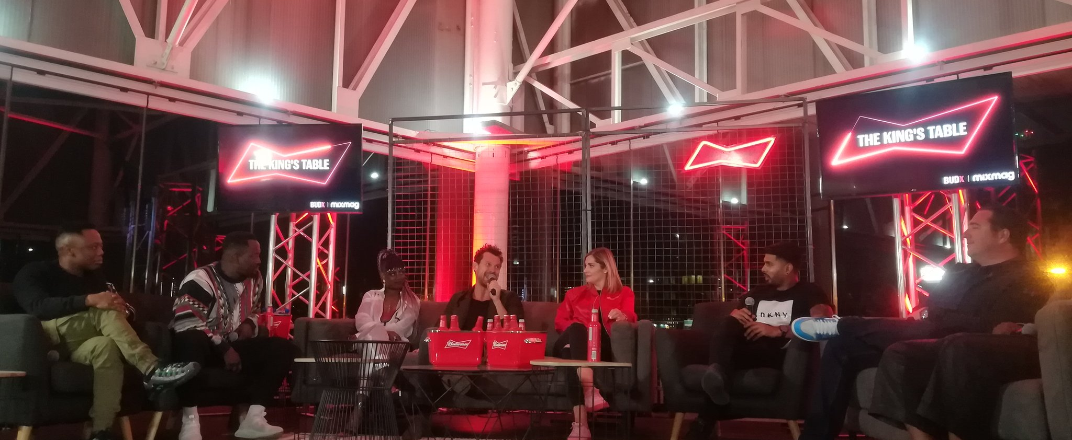
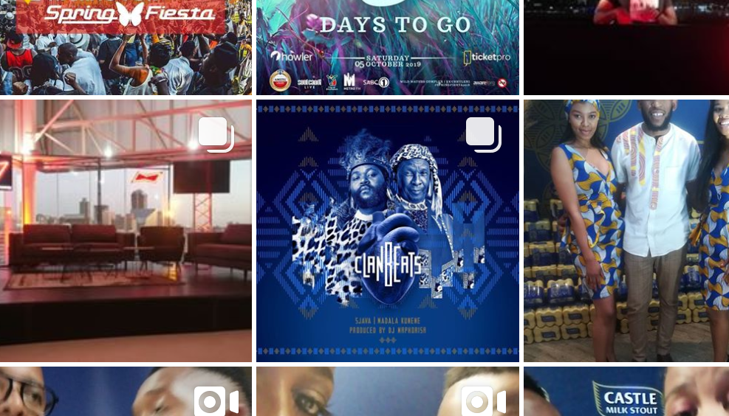
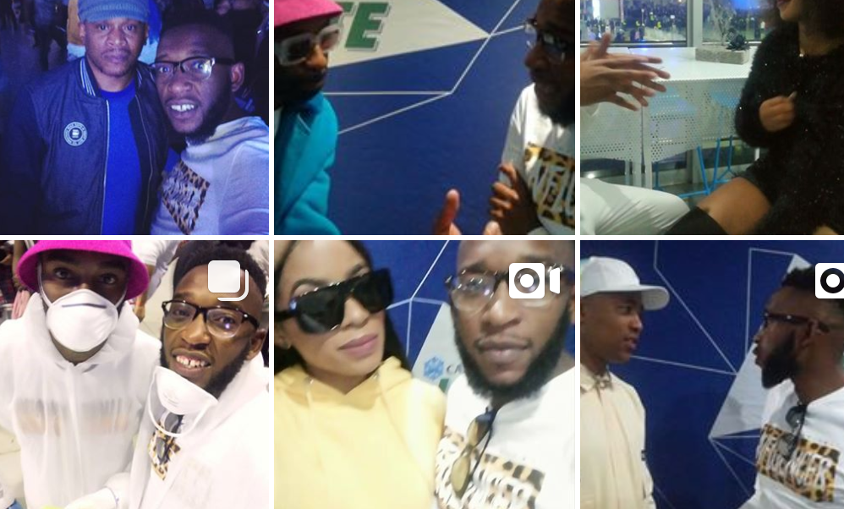
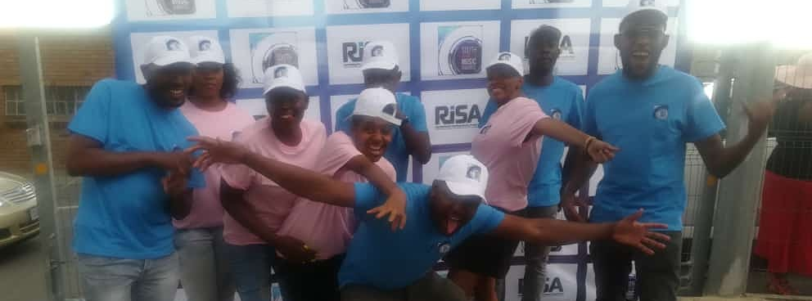

Slide 8
CONTACT DETAILS:
Address: 2139 Braamfischerville Phase 1 Roodepoort 1724
Email: Macawesomezasocialmedia@gmail.com
Cell: 074 401 4215
Twitter: @MacAweSocialMe
Instagram: macawesomezasocialmedia
Facebook: https://www.facebook.com/MacAweSocialMe
REG: (2016/226540/07)

